Slide 1
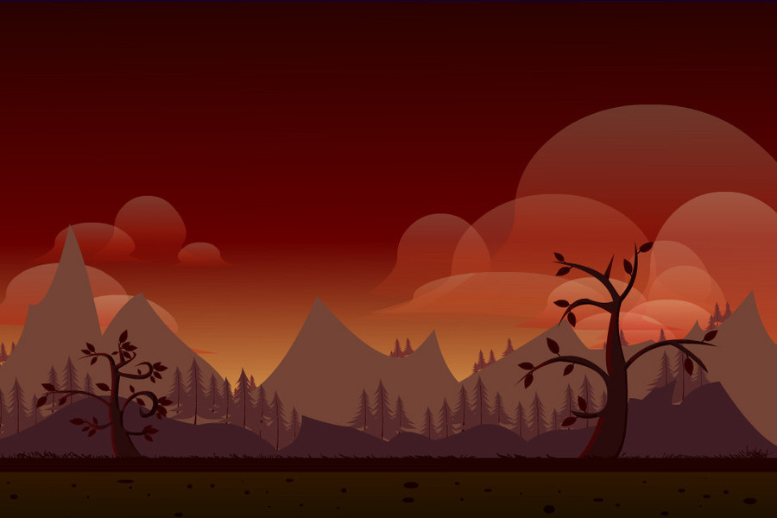

The Undertaker
NEW GAME
TUTORIAL
TEAM “NEW ORLEANS“
LEADER BOARD

Slide 2
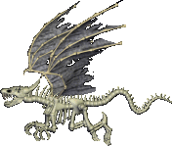

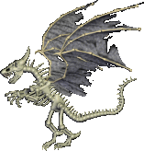
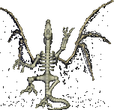
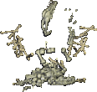

ABOUT THE UNDERTAKER
The Undertaker is a GUI video game, written in Java and developed by team New Orleans for the Java Fundamentals teamwork at SoftUni.
The main theme of the game is a battle between a lone soldier, who has to fight with numerous monsters, such as dragons, dinosaurs, etc.

Slide 3


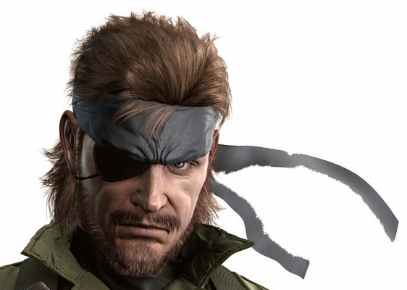
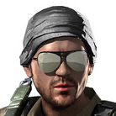


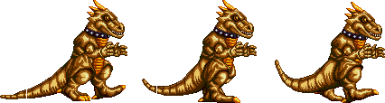
THE TEAM
SIMEON
VANOV
VIKTORIA
TENEVA
EDWARD
SLAVOV
VIKTOR
MARINOV
KIRIL
TODOROV
Divided the code in different classes and states;
Created the Display, EnemyGenerator, Game,Handler, GameObject and Leaderboard classes.
Enemies classes creation – Dinosaur, Flying Dragon, Octopus, Octopus_T including attacking logic and movement design;
Health bar improvements.
Created Main Menu, Tutorial and Game Over states;
Code refactoring;
Debugging.
Made player sprite sheet;
Moving and jumping;
Added bullets and basic collision.
Created the health class;
Scoring Class.

Slide 4

AND THANK YOU FOR YOUR ATTENTION!

